Slide 1




Work Package 4
Foresight Study for Geographical Extension:
the Global Multi-Hub Network
Jiří Kvaček, Narodni muzeum, Praha
4D4Life Opening Meeting, 15-17 September, Reading, UK

Slide 2



Aims:
Introduction
Methods
Networking
Partners (Multihubs)
Objectives
Description of work
Deliverables
4D4Life Opening Meeting, 15-17 September, Reading, UK

Slide 3
Introduction
Workpackage 4 establishes a completely new network that represents the extension of the programme to become truly global. Through networks of Regional Centres it will form a ring of Regional Taxonomic Database Hubs.
This development will extend both the data coverage and the organisational coverage of Species 2000 eventually to
every region of the world.
4D4Life Opening Meeting, 15-17 September, Reading, UK

Slide 4
Key issue
A key issue in the programme is data for the missing species – at 1.2 million species in the current system, there are an estimated 700,000 species still missing.
4D4Life Opening Meeting, 15-17 September, Reading, UK

Slide 5
Methodology
The proposed development of Regional Hubs in a Multi-Hub Network have the technical and institutional potential to enlarge this currently Europe-based programme to become a truly global network and scientific infrastructure.
It is proposed to network with the leaders of these developments in the first batch of agreed regional centres – in China, New Zealand, Australia, Brazil and N. America.
At the technical level the group will both evaluate the test-bed implementation available with three regional hubs (European, N. America and China) and draw up a proposed concept and specification for the working of the regional Hubs.
At the institutional level we will try to draw up a model for how the regional centres may interact with the present global programme, with its residual legal body, its elected Directors, and its global Team.
4D4Life Opening Meeting, 15-17 September, Reading, UK

Slide 6
Networking Activities
Overall Strategy
The Networking Activities are designed to foster a culture of co-operation both between the partners in the programme, and between them and the different user communities – something that is new and has not been undertaken before. The intention is to generate from these activities both a stronger more professional infrastructure organisation and an enriched and more valuable set of scientific services. These activities have the goal of both raising levels of cooperation and bringing new or enhanced service capability to the programme.
4D4Life Opening Meeting, 15-17 September, Reading, UK

Slide 7
Networking
The object is to discuss a range of concepts and proposals, and to agree an overall concept and implementation strategy. Multi-Hub Network can be prototyped, and later implemented.
The Workpackage does depend on modest funds being made available for the Multi-Hub Network partners from outside Europe to take part. In each case the major funding of the Regional Hub has already, or will shortly be made available from other sources in their own region.
For each of these five partners, we make the special case that a senior or technical staff member from that organisation will be needed for these consultations and for several meetings.
4D4Life Opening Meeting, 15-17 September, Reading, UK

Slide 8
- The Species 2000 China Node - already established and funded by the Chinese Academy of Sciences;
Catalogo da Vida Brasil, working with the Brazilian Ministry of Science & Technology;
- New Zealand Organism Register (NZOR) nationally funded at LandCare
Research, a Crown Institute;
- the Integrated Taxonomic Information System (ITIS) a US Federal Government project at the Smithsonian Institution, National Museum of Natural History;
- Atlas of Living Australia (ALA) a federally funded programme.
Partners
Multi-hub Network
4D4Life Opening Meeting, 15-17 September, Reading, UK

Slide 9
Implementation
Implementation of Regional Taxonomic Database Hubs into the current system of Species 2000:
Architecture 1 – Species 2000 concept
Architecture 2 – Multi-hub concept
4D4Life Opening Meeting, 15-17 September, Reading, UK

Slide 10
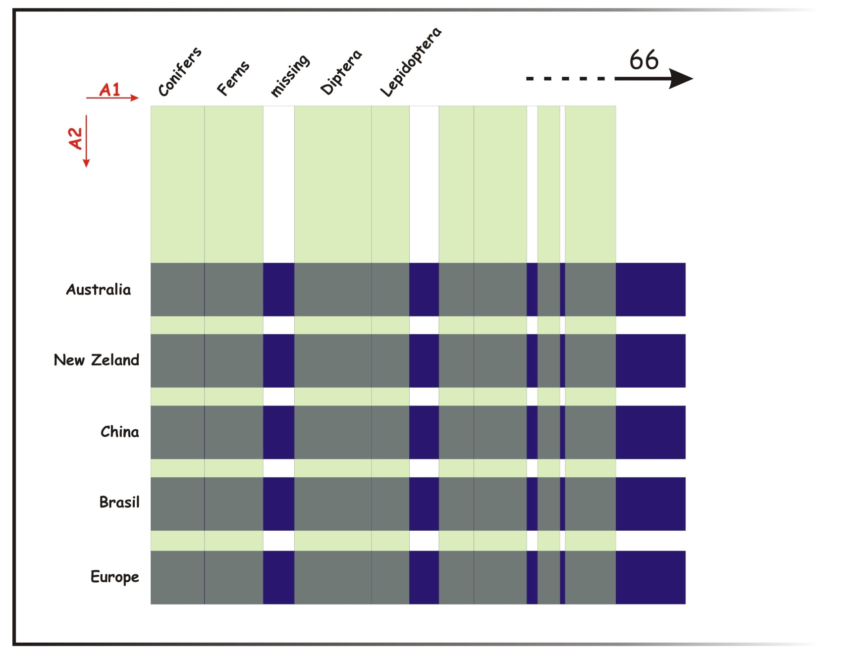
Implementation of Regional Taxonomic Database Hubs into the current system of Species 2000:
4D4Life Opening Meeting, 15-17 September, Reading, UK

Slide 11
Objectives
To bring together leaders of the various international centres from around the world that have committed to create Regional Hubs in the Sp2000 Multi-Hub Network.
We will work together in Networking, Discussion and Design.
4D4Life Opening Meeting, 15-17 September, Reading, UK

Slide 12
Objectives
Foresight Study to report the Needs, Conceptualisation, Specification and subsequently the Design both for individual Regional Hubs, and for the Multi-Hub network as a whole.
4D4Life Opening Meeting, 15-17 September, Reading, UK

Slide 13
Objectives
To carry out a limited amount of prototyping and testing to explore the concepts and design features agreed.
4D4Life Opening Meeting, 15-17 September, Reading, UK

Slide 14
Objectives
Foresight Study to point the way for other potential regional hub centres, not yet part of the Multi-Hub Network, to form Regional Hubs and join the Network in future, with a view of eventually completing coverage of all continents and oceans, and of including centres from less-advantaged parts of the world in possible future projects.
4D4Life Opening Meeting, 15-17 September, Reading, UK

Slide 15
Description of work
Task 4.1 Network consultation and workshop discussions among regional hub organisers:
- to debate the Needs, Concepts and Specification for the Multi-Hub Network at both the taxonomic and the technical level, leading to a Preliminary Specification with outstanding issues highlighted.
4D4Life Opening Meeting, 15-17 September, Reading, UK

Slide 16
Description of work
Task 4.1
to discuss building on the Preliminary Specification and the Pilot Projects leading to a firm Concept
and Specification of the Multi-Hub Network.
4D4Life Opening Meeting, 15-17 September, Reading, UK

Slide 17
Description of work
Task 4.1
- to propose an institutional structure for Multi-hub Network within Sp2000, and what structural changes may be needed.
- to report on the Pilot Projects.
- to prepare an outline plan for the extension of the Multi-Hub Network to cover the whole world, and to include new centres, some from less advantaged parts of the world.
4D4Life Opening Meeting, 15-17 September, Reading, UK

Slide 18
Description of work
Task 4.2
A small number of possible Pilot Projects, depending on the partners resources:
- for prototyping and testing based on the limited Multi-Hub Linkage tools available with the present SPICE system within Sp2000.
4D4Life Opening Meeting, 15-17 September, Reading, UK

Slide 19
Deliverables
D4.1 month 12 Report on preliminary concept, requirements and specifications for the Global Multi-Hub
Network: the Preliminary Requirements Document.
4D4Life Opening Meeting, 15-17 September, Reading, UK

Slide 20
Deliverables
D4.2 month 24 Global Multi-Hub Network Design Document, including both a technical design component and an institutional design component.
4D4Life Opening Meeting, 15-17 September, Reading, UK

Slide 21
Thank you for your attention
4D4Life Opening Meeting, 15-17 September, Reading, UK

